Slide 1



Periperi U*: A Collaborative Programme in Capacity Development in Disaster Risk Reduction – Through African Universities
Global Platform for Disaster Risk Reduction
Geneva, 22 May, 2013
D. Benouar^{1,} A. Holloway²
¹USTHB, Faculty of Civil Engineering, Alger, Algeria, E-mail dbenouar@gmail.com
²Disaster Mitigation for Sustainable Livelihoods Programme, Stellenbosch University, Stellenbosch, South Africa; E-mail: ailsaholloway@sun.ac.za
*Partners enhancing resilience for people exposed to risks – with a focus on active university engagement

Slide 2
Two years ago, we argued that …
we had to ‘shake-off’ past barriers to scholarly engagement in the disaster risk domain,
and
reverse the legacy of reactive disaster response that has been historically ‘de-linked’ from the continent’s HED institutions…

Slide 3
We also argued that from an educational perspective, the disaster risk domain is:
Disciplinary and multidisciplinary (can be conceptualised within individual disciplines , eg engineering or public health)
and
Transdisciplinary (it must integrate knowledges across different disciplines) as well as …
… actively engage scholarship and practice

Slide 4

.. and it needed
an appropriate DRR ‘knowledge management architecture’ for different disciplines, languages, organisations & contexts
to align educational efforts with those of other interest groups,
but … would not constrain responsiveness, innovation and prospects for sustainability.

Slide 5
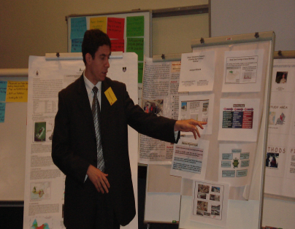
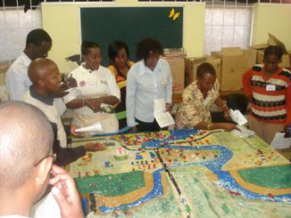
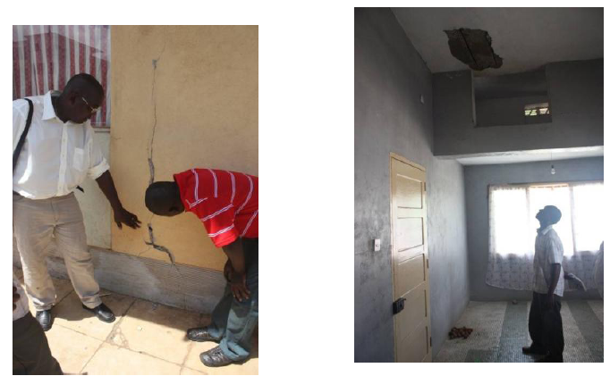
This led to Periperi U
To mobilise local energies/skill in 10 African universities to build context-specific DRR capabilities in:
formal education,
  short course training,
  local research
  risk and vulnerability reduction
  policy advocacy

Slide 6
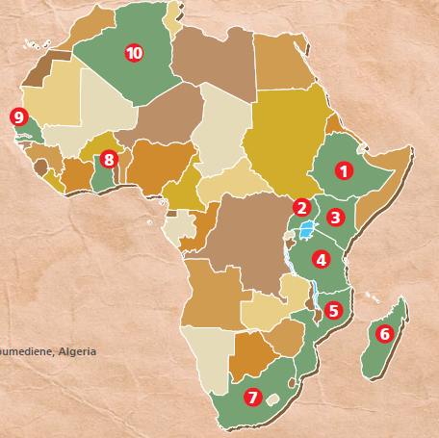
And now, Periperi U - purposive partnership …
Bahir Dar Univ.
Makerere Univ.
Moi Univ.
Ardhi Univ.
Technical Univ. Mozambique
Univ. of Antananarivo
Stellenbosch Univ.
Univ. of Ghana
Gaston Berger Univ.
Univ. Science & Technology Houari Boumediene
… ‘virtual centre’ for DRM capacity building in Africa

Slide 7
How does Periperi U work?
Applies core elements of applied scholarship to disaster risk domain:
Teaching and learning
Research and innovation
Community outreach or social responsiveness
Disaster risk-related academic programmes
DRM/DRR short courses
Disaster risk related academic and commissioned research
Support to local/national DRR policy & practice

Slide 8

What does this entail … and achieved since 2008
10 African universities - 74 Staff members
12 DRM practice fields - 8 Languages
POSTGRAD DEGREES
7 postgrad. degrees
82 graduates so far
120 enrolled now
UNDERGRAD DEGREES
2 DRR undergrad. degrees
380 graduates
139 enrolled now
SHORT COURSES
35 focal areas
86 short courses 2,220 practitioners trained.
EVEN MORE…
3 Masters degrees in 2013
4 more Masters degrees await approval
EVEN MORE…
3 Masters degrees launching in 2013
4 more Masters degrees await approval

Slide 9
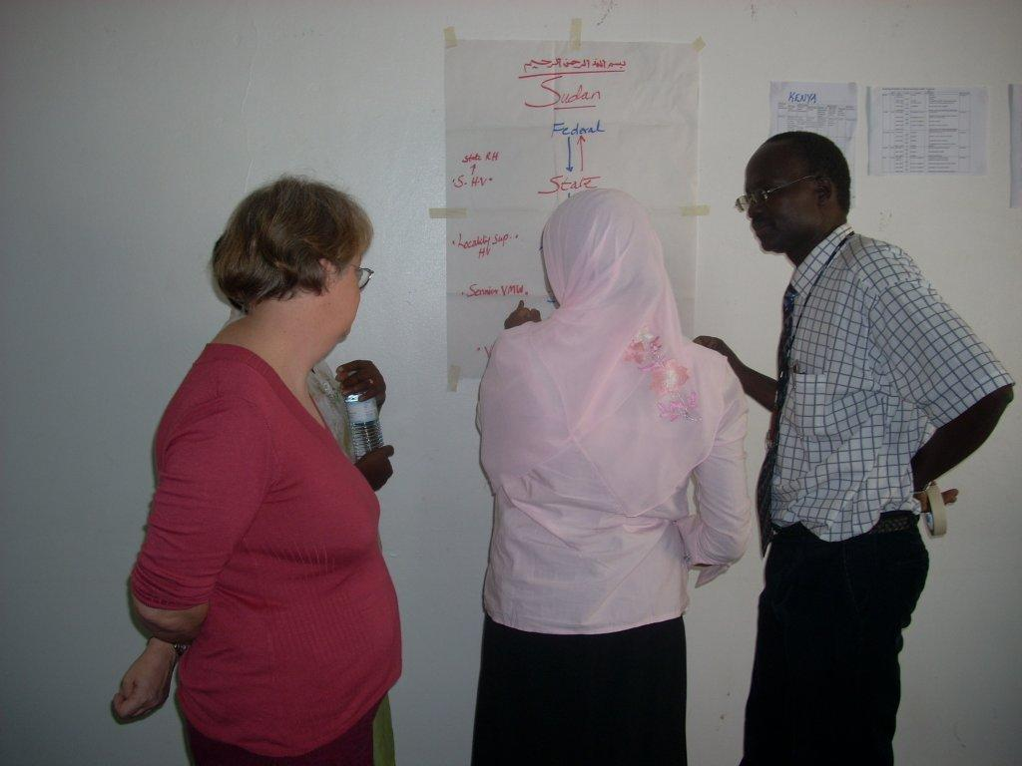
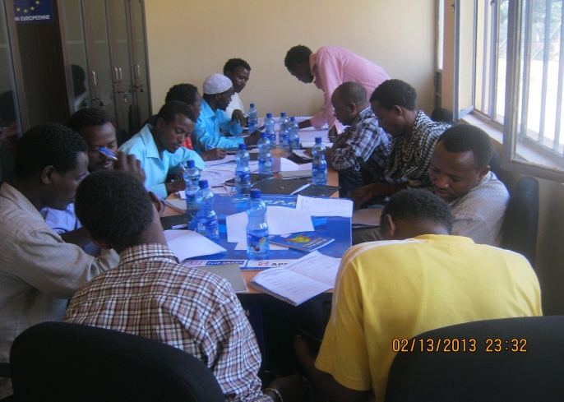
17 different short courses, eg …
Use of GIS for Disaster Risk Reduction USTHB
From Food Aid to Food Security BDU
Public Health in Complex Emergencies Makerere
Intro to DRR in Urban Areas Univ. of Ghana
Economic Valuation Methods & DRR Tàna

Slide 10
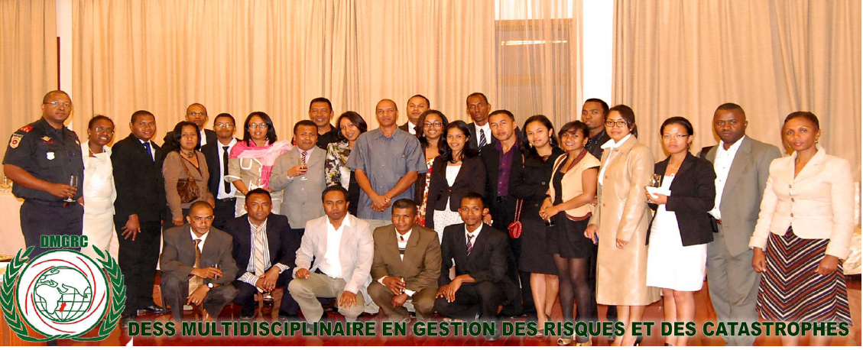
Disaster risk-related masters progs up & running, eg
Masters DRM & Sustainable Development BDU Masters in DRM Ardhi
Masters in Multidisciplinary Disaster
and Risk Management Tàna
Magister in DRM U. Mostaganem

Slide 11
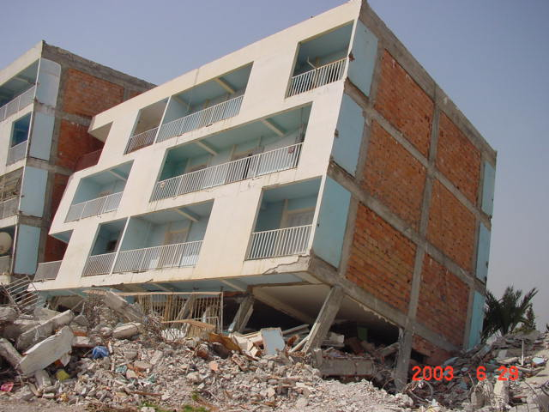
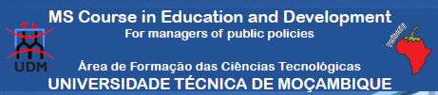
More Masters programmes coming on-line 2013
MSc Earthquake Engineering & DRM USTHB
MPH in Disaster Management Makerere
Masters in Risk Reduction & Management
Of Crises in Africa GBU
Masters in Education and Development UDM

Slide 12
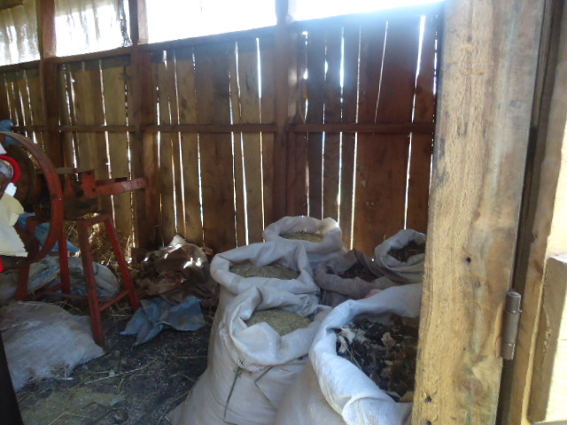
…and insights on local risks from postgraduate research, eg
Urban DRR analysis of the role of settlement planning in Dar Es Salaam, Tanzania (Ardhi)
Climate – induced vulnerability to food insecurity in pastoral areas of Ethiopia: case of Afar Regional State (BDU)
Transference of aflatoxin in animal feeds to livestock (Moi)
Poor animal feed storage conditions

Slide 13
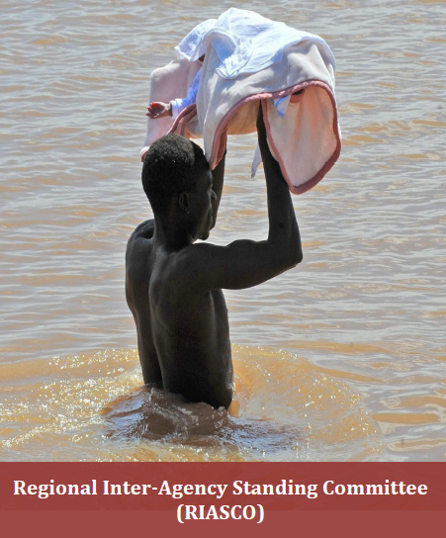
+ Growing Capacity for Commissioned Research
Humanitarian Trends Study for southern Africa
(14 countries)
Regional Interagency Standing Committee (RIASCO) in Southern Africa
(UDM, Tàna, SU, NWU)

Slide 14

Want to know more?
Go to … www.riskreductionafrica.org

Slide 15
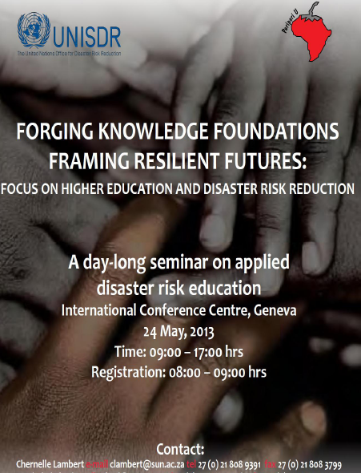
Want to know even more?
Please join us in:
Room 6, Level 3 Friday, 24 May
http://www.unisdr.org/we/inform/events/32982

